Slide 1
Combined test QA: What , why and how?
Notes:
What: the process we are looking at (combined screening)
Why: why we need QA
How: a system of QA based on feedback and support

Slide 2

How : An effective system of feedback

Slide 3
Achieving consistency
To achieve greater consistency
  Adopt a particular standard
  Provide feedback
  Encourage dialogue
  Provide support
Notes:
This is what we are trying to achieve with the QA program for NT.

Slide 4
Quality Assurance Support
Report production
Feedback
Improvements
Data submissions

Slide 5
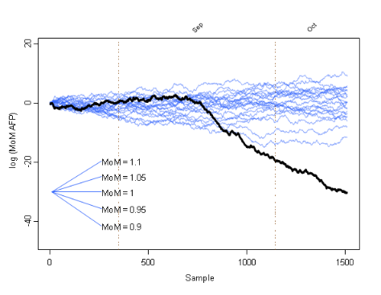
~400,000 screening
tests per year
~2,000 sonographers
~200 hospital units
~20 Laboratories
2,000 sonographers
Hospital unit
Laboratory
Hospital unit
Laboratory
Hospital unit
Laboratory
etc.

Slide 6
Diagnostics for biochemistry
MoM values should be centred on 1.0 when viewed together, by gestation, by weight, by smoking status, by ethnicity …
Small deviations from this target can have important implications for screening

Slide 7
Gestational age
Cycle 2
✗
Cycle 7
✓

Slide 8
Maternal weight
Cycle 2
✗
Cycle 7
✓

Slide 9
Smoking status
Cycle 2
✗
Cycle 7
✓

Slide 10
Ethnicity
Cycle 2
✗
Cycle 7
✓

Slide 11
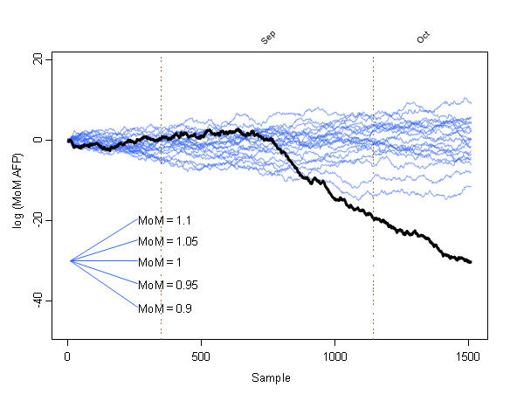
CUSUM charts for detecting change points

Slide 12
Diagnostics for NT

Slide 13
Diagnostics: Nuchal Translucency
Expected relationship with CRL
Expected degree of scatter about the curve
Notes:
We expect to see a certain relationship between measurements of NT and CRL taken according to the FMF standards.
The trend with CRL according to the FMF reference curve
The spread of points about the curve
The presence of a small proportion of unusually large NT measurements

Slide 14
Bias
Notes:
The ideal plot is on the left. The plot on the right shows a large negative bias.
Why does this sort of bias arise?
What effect would there be on individual risks?
What effect would there be on overall screening performance?

Slide 15
Bias
Notes:
The ideal plot is on the left. The plot on the right shows a large positive bias.
Why does this sort of bias arise?
What effect would there be on individual risks?
What effect would there be on overall screening performance?

Slide 16
Spread
Notes:
The ideal plot is on the left. The plot on the right shows much more spread.
Why might this arise?
What effect would there be on individual risks?
What effect would there be on overall screening performance?

Slide 17
Spread
Notes:
The ideal plot is on the left. The plot on the right shows much less spread.
Why might this arise?
What effect would there be on individual risks?
What effect would there be on overall screening performance?

Slide 18
Trend
Notes:
Another example of a trend deviation.
Why might this arise?
What effect would there be on individual risks?
What effect would there be on overall screening performance?

Slide 19
Trend
Notes:
The ideal plot is on the left. The plot on the right shows different biases at different CRLs.
Why might this arise?
What effect would there be on individual risks?
What effect would there be on overall screening performance?

Slide 20
A note of caution
Adverse impacts of audit (integrity of measurement)
Too good to be true?
Notes:
An example of measurement towards the curve.
The integrity of the measurement process is questionable.
Is this an unintended consequence of QA.

Slide 21
Summary
Feedback and support to sonographers laboratories, hospitals and suppliers
Monitoring at the local and national level
A national database: evidence on screening parameters, effects of smoking ethnicity etc.

Slide 22
Thank you!

